Slide 1


Casi Clinici
Giovanni Funiciello

Slide 2
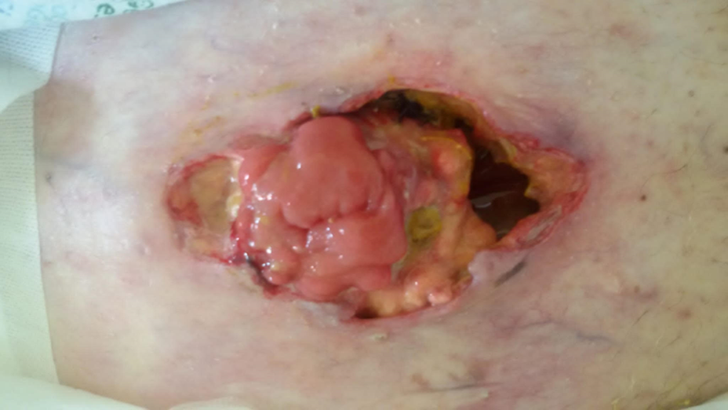
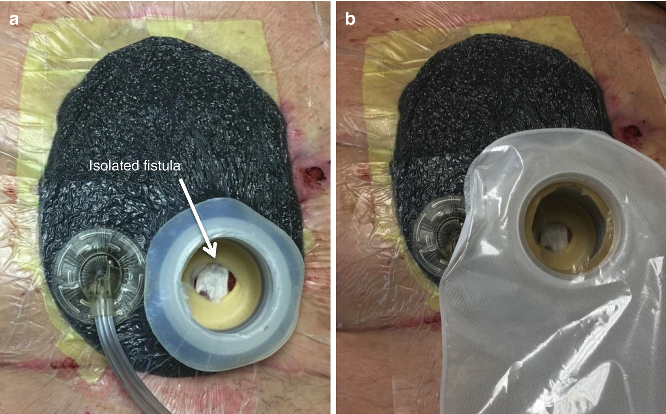
Giovanni Funiciello

Slide 3
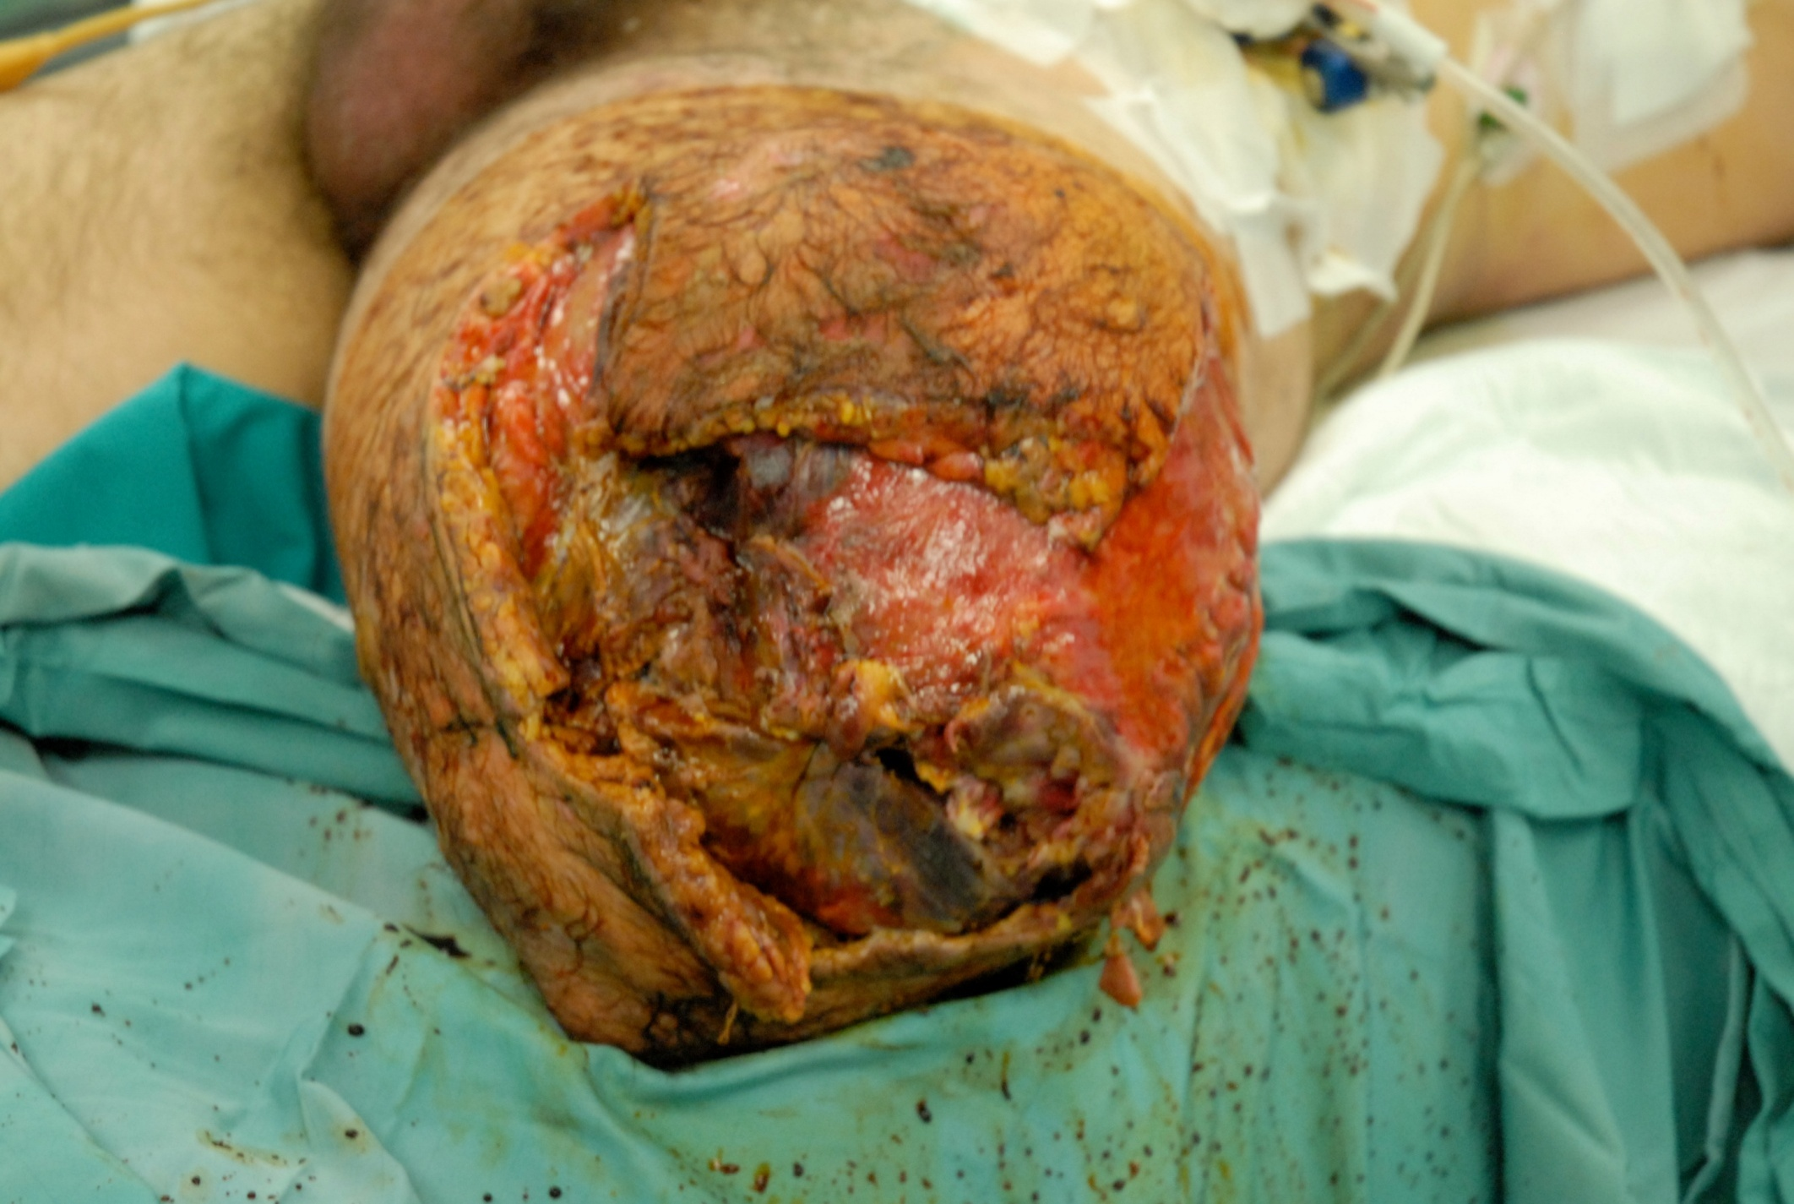
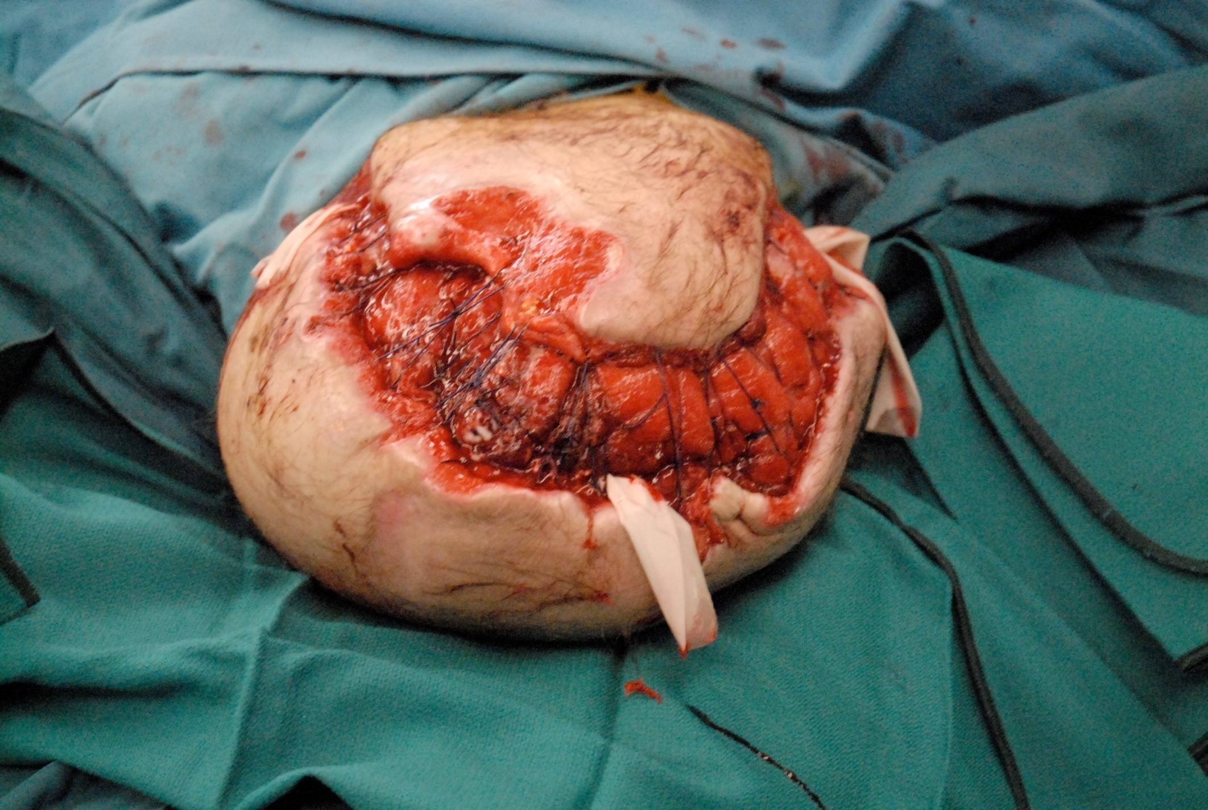
Giovanni Funiciello

Slide 4
Impact of a bundle on surgical site infections after hip arthroplasty: A cohort study in Italy (2012-2019)
Costanza Vicentini ¹, Alessio Corradi ², Alessandro Scacchi ³, Heba Safwat Mhmoued Abdo Elhadidy ⁴, Maria Francesca Furmenti ⁵, Francesca Quattrocolo ⁶, Carla Maria Zotti ⁷
Level of implementation of multimodal strategies for infection prevention and control interventions and prevalence of healthcare-associated infections in Northern Italy.
Vicentini C, Bussolino R, Gastaldo C, Castagnotto M, D'Ancona FP, Zotti CM; Working group “Unità Prevenzione Rischio Infettivo (UPRI), Regione Piemonte”
Giovanni Funiciello

Slide 5
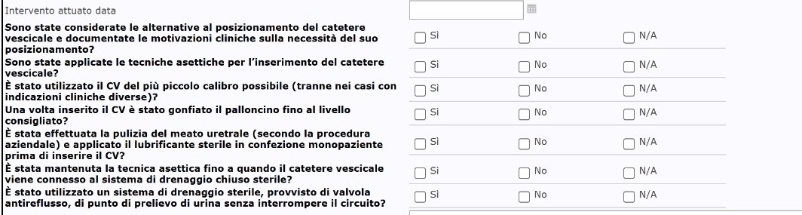
Giovanni Funiciello

Slide 6
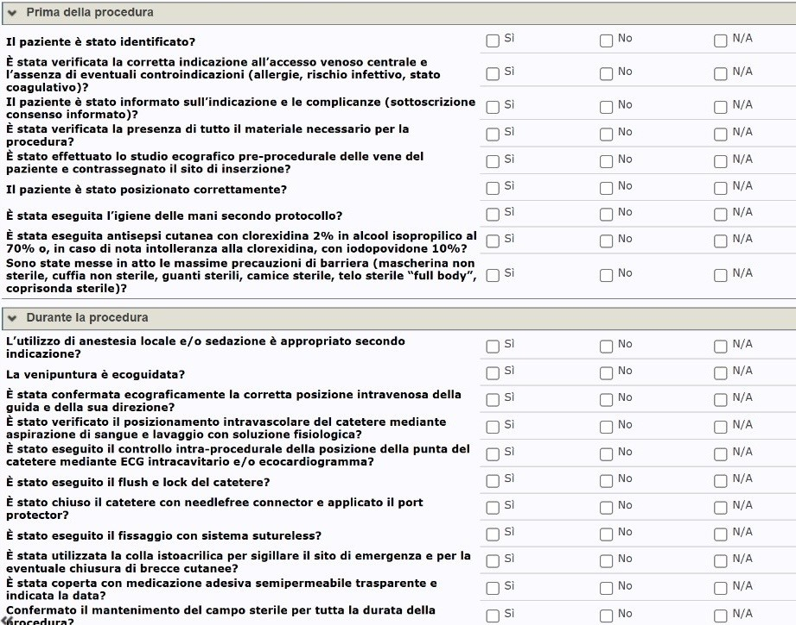
Giovanni Funiciello

Slide 7
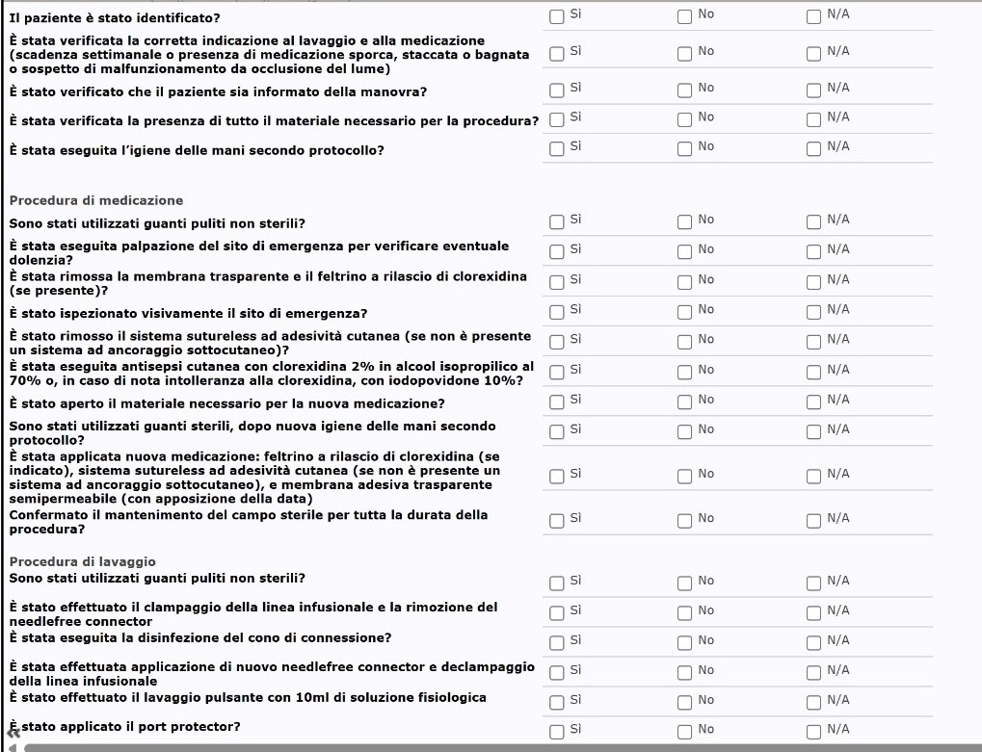
Giovanni Funiciello

Slide 8
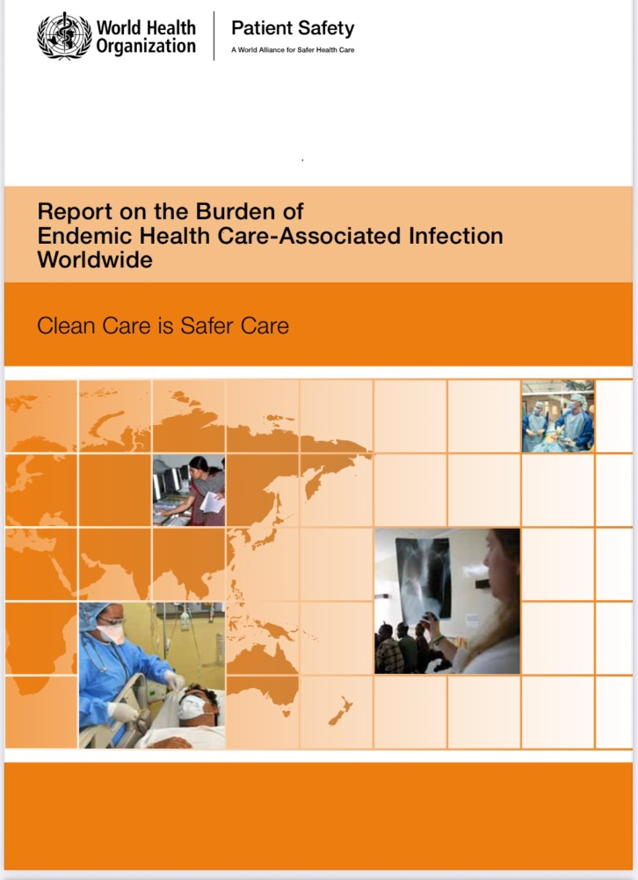

Giovanni Funiciello

Slide 9


Giovanni Funiciello

Slide 10
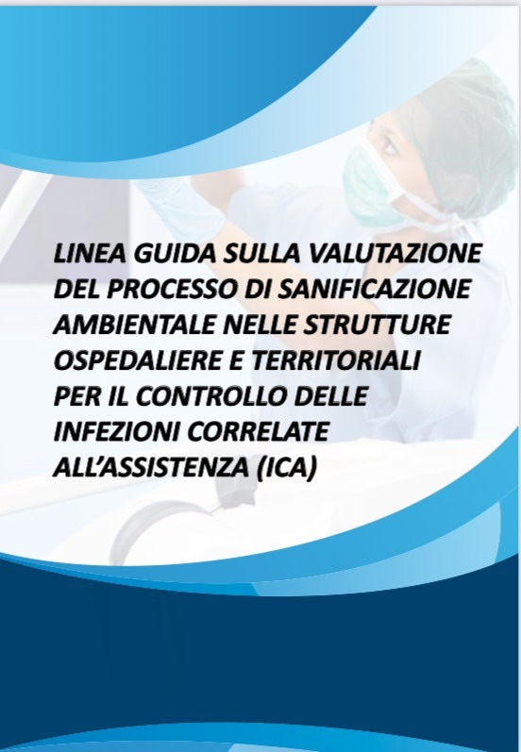

Giovanni Funiciello

Slide 11
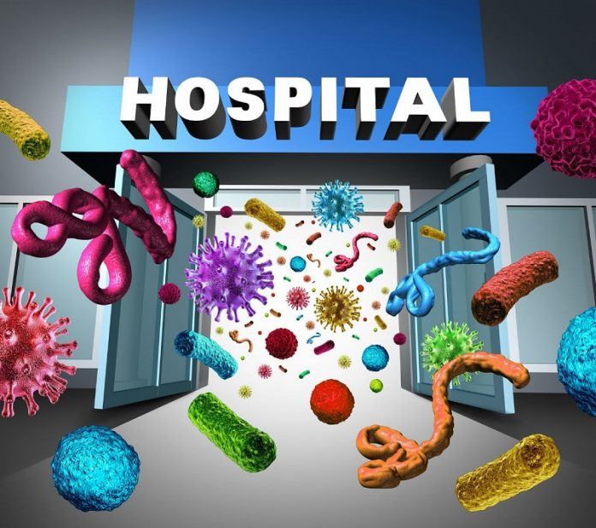
Grazie per l’attenzione
Giovanni Funiciello

